Slide 1
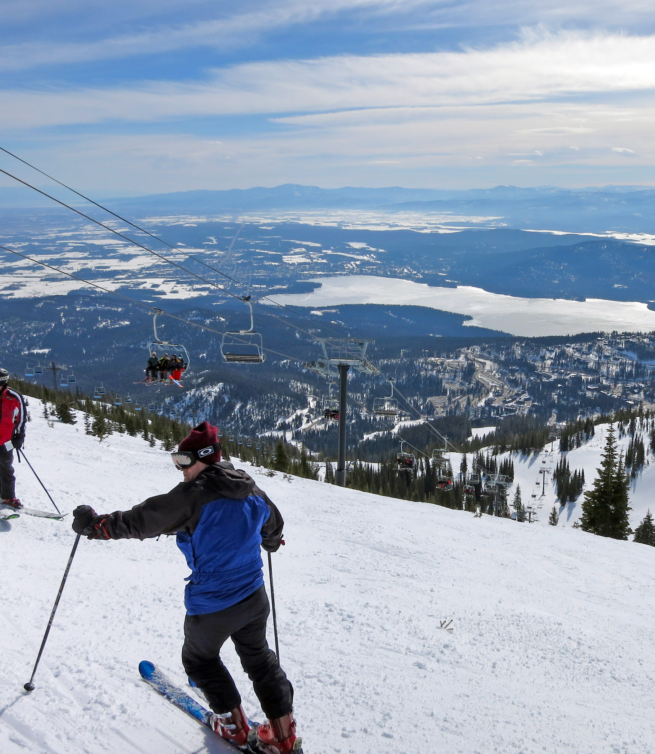
Executive Presentation: Optimizing Pricing Strategy for Big Mountain Resort

Slide 2
Problem Identification
Issue: Big Mountain Resort is currently facing the challenge of finding the right balance between pricing its tickets competitively and providing excellent value to its guests. In this report, I'll share the insights gained and offer recommendations based on the analysis conducted as part of our guided capstone project.
Objective: To recommend a pricing strategy that maximizes revenue while providing value to guests.

Slide 3
Recommendation and Key Findings
Recommendation: At present, Big Mountain Resort charges $81 for a ticket. Our modeling suggests that the market could support a ticket price of around $95. This indicates there's room for the resort to adjust its prices to better match what customers expect.
Impact of Additional Facilities: Adding a new chair lift would significantly boost the predicted ticket price. This suggests that investing in new facilities, like the proposed chair lift, could help Big Mountain justify a higher ticket price and improve its offerings.
Revenue Analysis: We also looked at how different scenarios, such as closing certain runs, could affect revenue. Analyzing these predictions can help Big Mountain make smart decisions about pricing and investments to maximize revenue without sacrificing customer satisfaction.

Slide 4
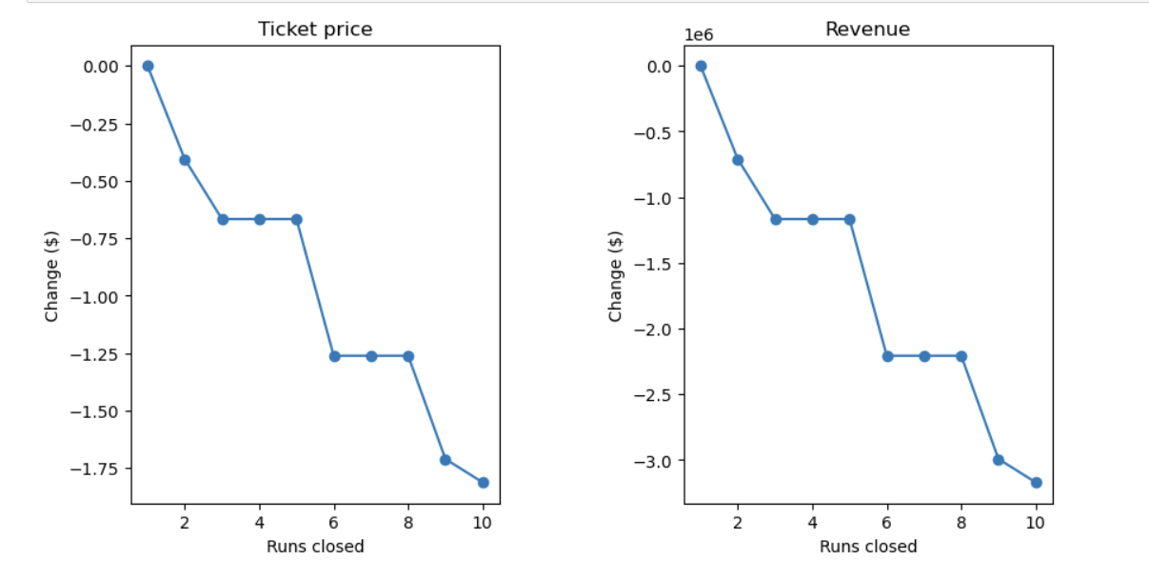
The model says closing one run makes no difference. Closing 2 and 3 successively reduces support for ticket price and so revenue. If Big Mountain closes down 3 runs, it seems they may as well close down 4 or 5 as there's no further loss in ticket price. Increasing the closures down to 6 or more leads to a large drop. Image below:

Slide 5
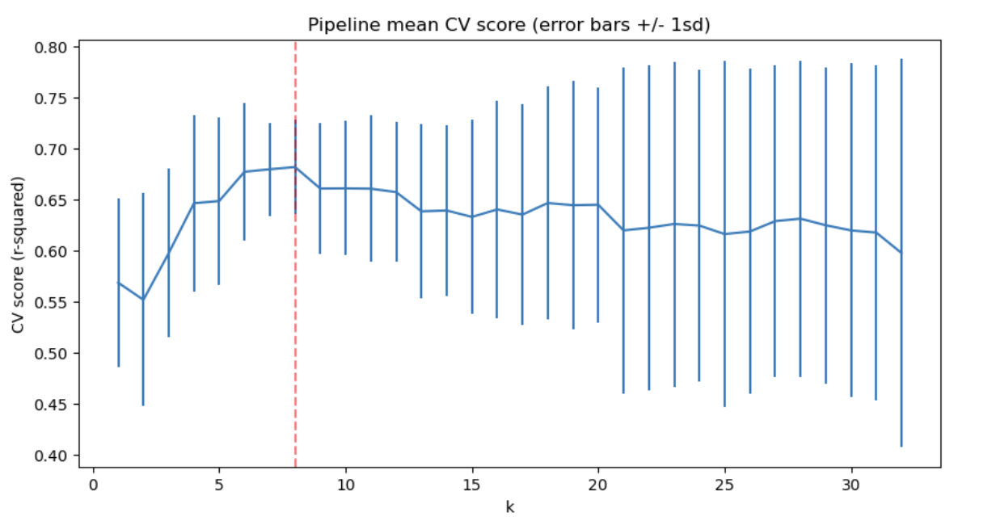
MODELS:
Linear Regression Model
We created a pipeline that
imputes missing values
scales the data
selects the k best features
trains a linear regression model
a technique (cross-validation) for estimating model performance
The above suggests a good value for k is 8. There was an initial rapid increase with k, followed by a slow decline. Also noticeable is the variance of the results greatly increases above k=8.
Our final findings:
These results suggest that vertical drop is your biggest positive feature. This makes intuitive sense and is consistent with what you saw during the EDA work. Also, you see the area covered by snow making equipment is a strong positive as well. People like guaranteed skiing! The skiable terrain area is negatively associated with ticket price! This seems odd. People will pay less for larger resorts. There could be all manner of reasons for this. It could be an effect whereby larger resorts can host more visitors at any one time and so can charge less per ticket.

Slide 6
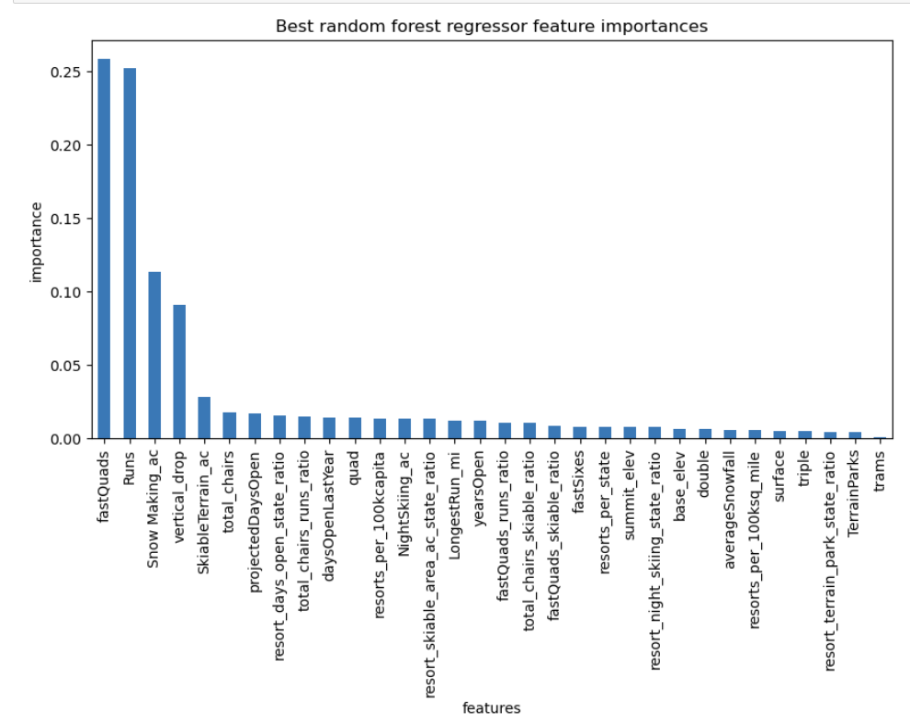
Random Forest Model
The Random Forest model is trained using historical data from Big Mountain Resort, including features such as terrain features, facilities, location, and other relevant factors.
The Random Forest model can assess the impact of adding new facilities, such as a chair lift, on ticket prices and overall revenue.
The Random Forest model allows for scenario analysis to explore the effects of different factors on revenue. For example, the model can simulate scenarios such as closing certain runs or adjusting pricing strategies to evaluate their impact on revenue.
The Random Forest model provides insights into the relative importance of different features in predicting ticket prices and revenue.
By analyzing feature importance, Big Mountain Resort can identify which factors have the greatest influence on revenue and prioritize investments accordingly.
For instance, the model may reveal that certain facilities or amenities have a significant impact on revenue, guiding decisions about where to allocate resources for future improvements.

Slide 7
Conclusion:
The random forest model has a lower cross-validation mean absolute error by almost ~$1. It also exhibits less variability. Verifying performance on the test set produces performance consistent with the cross-validation results.
In summary, our analysis provides valuable insights to help Big Mountain Resort fine-tune its pricing strategy and stay competitive in the ski resort industry. By following these recommendations and staying attuned to market dynamics, the resort can maximize revenue and keep guests happy on the slopes.
Future scope of work
Enhance Facilities: Move forward with plans to add a new chair lift to improve the resort's amenities and potentially justify the proposed ticket price increase.
Stay Informed: Keep a close eye on market trends, feedback from guests, and what competitors are doing to ensure decisions about pricing and investments are always well-informed.

